Slide 1


Biblically Responsible Investing
Quality Portfolios Built On Values
Copyright © 2021

Slide 2
Disclosures
Insert advisors disclaimers here:

Slide 3

Today’s
Speaker
Advisor Name
2-3 Sentence Bio

Slide 4

What is BRI?

Slide 5
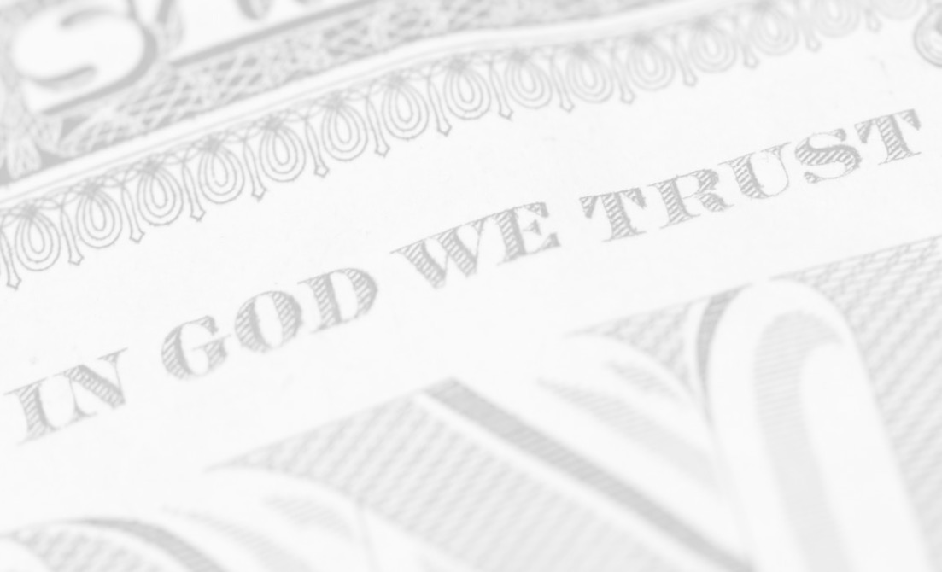
Biblically Responsible Investing:
Building quality portfolios of inspiring
companies that align with biblical values.
Notes:
The problem is, most investors have no idea what they are really invested in from an ESG/values based perspective.

Slide 6
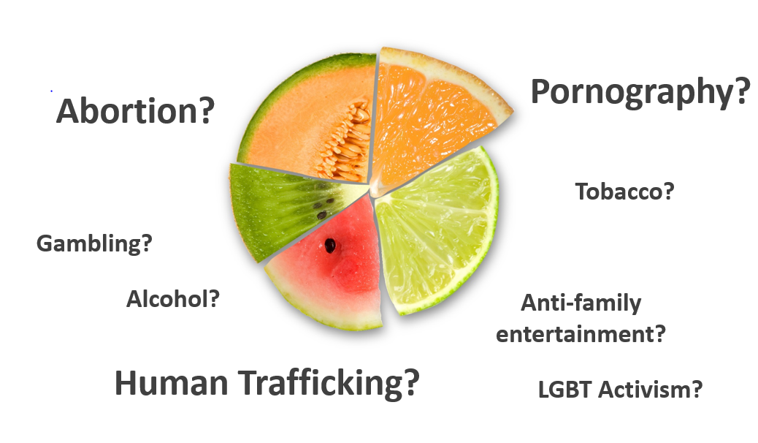
What are you really invested in?
Notes:
The problem is, most investors have no idea what they are really invested in from an ESG/values based perspective.

Slide 7
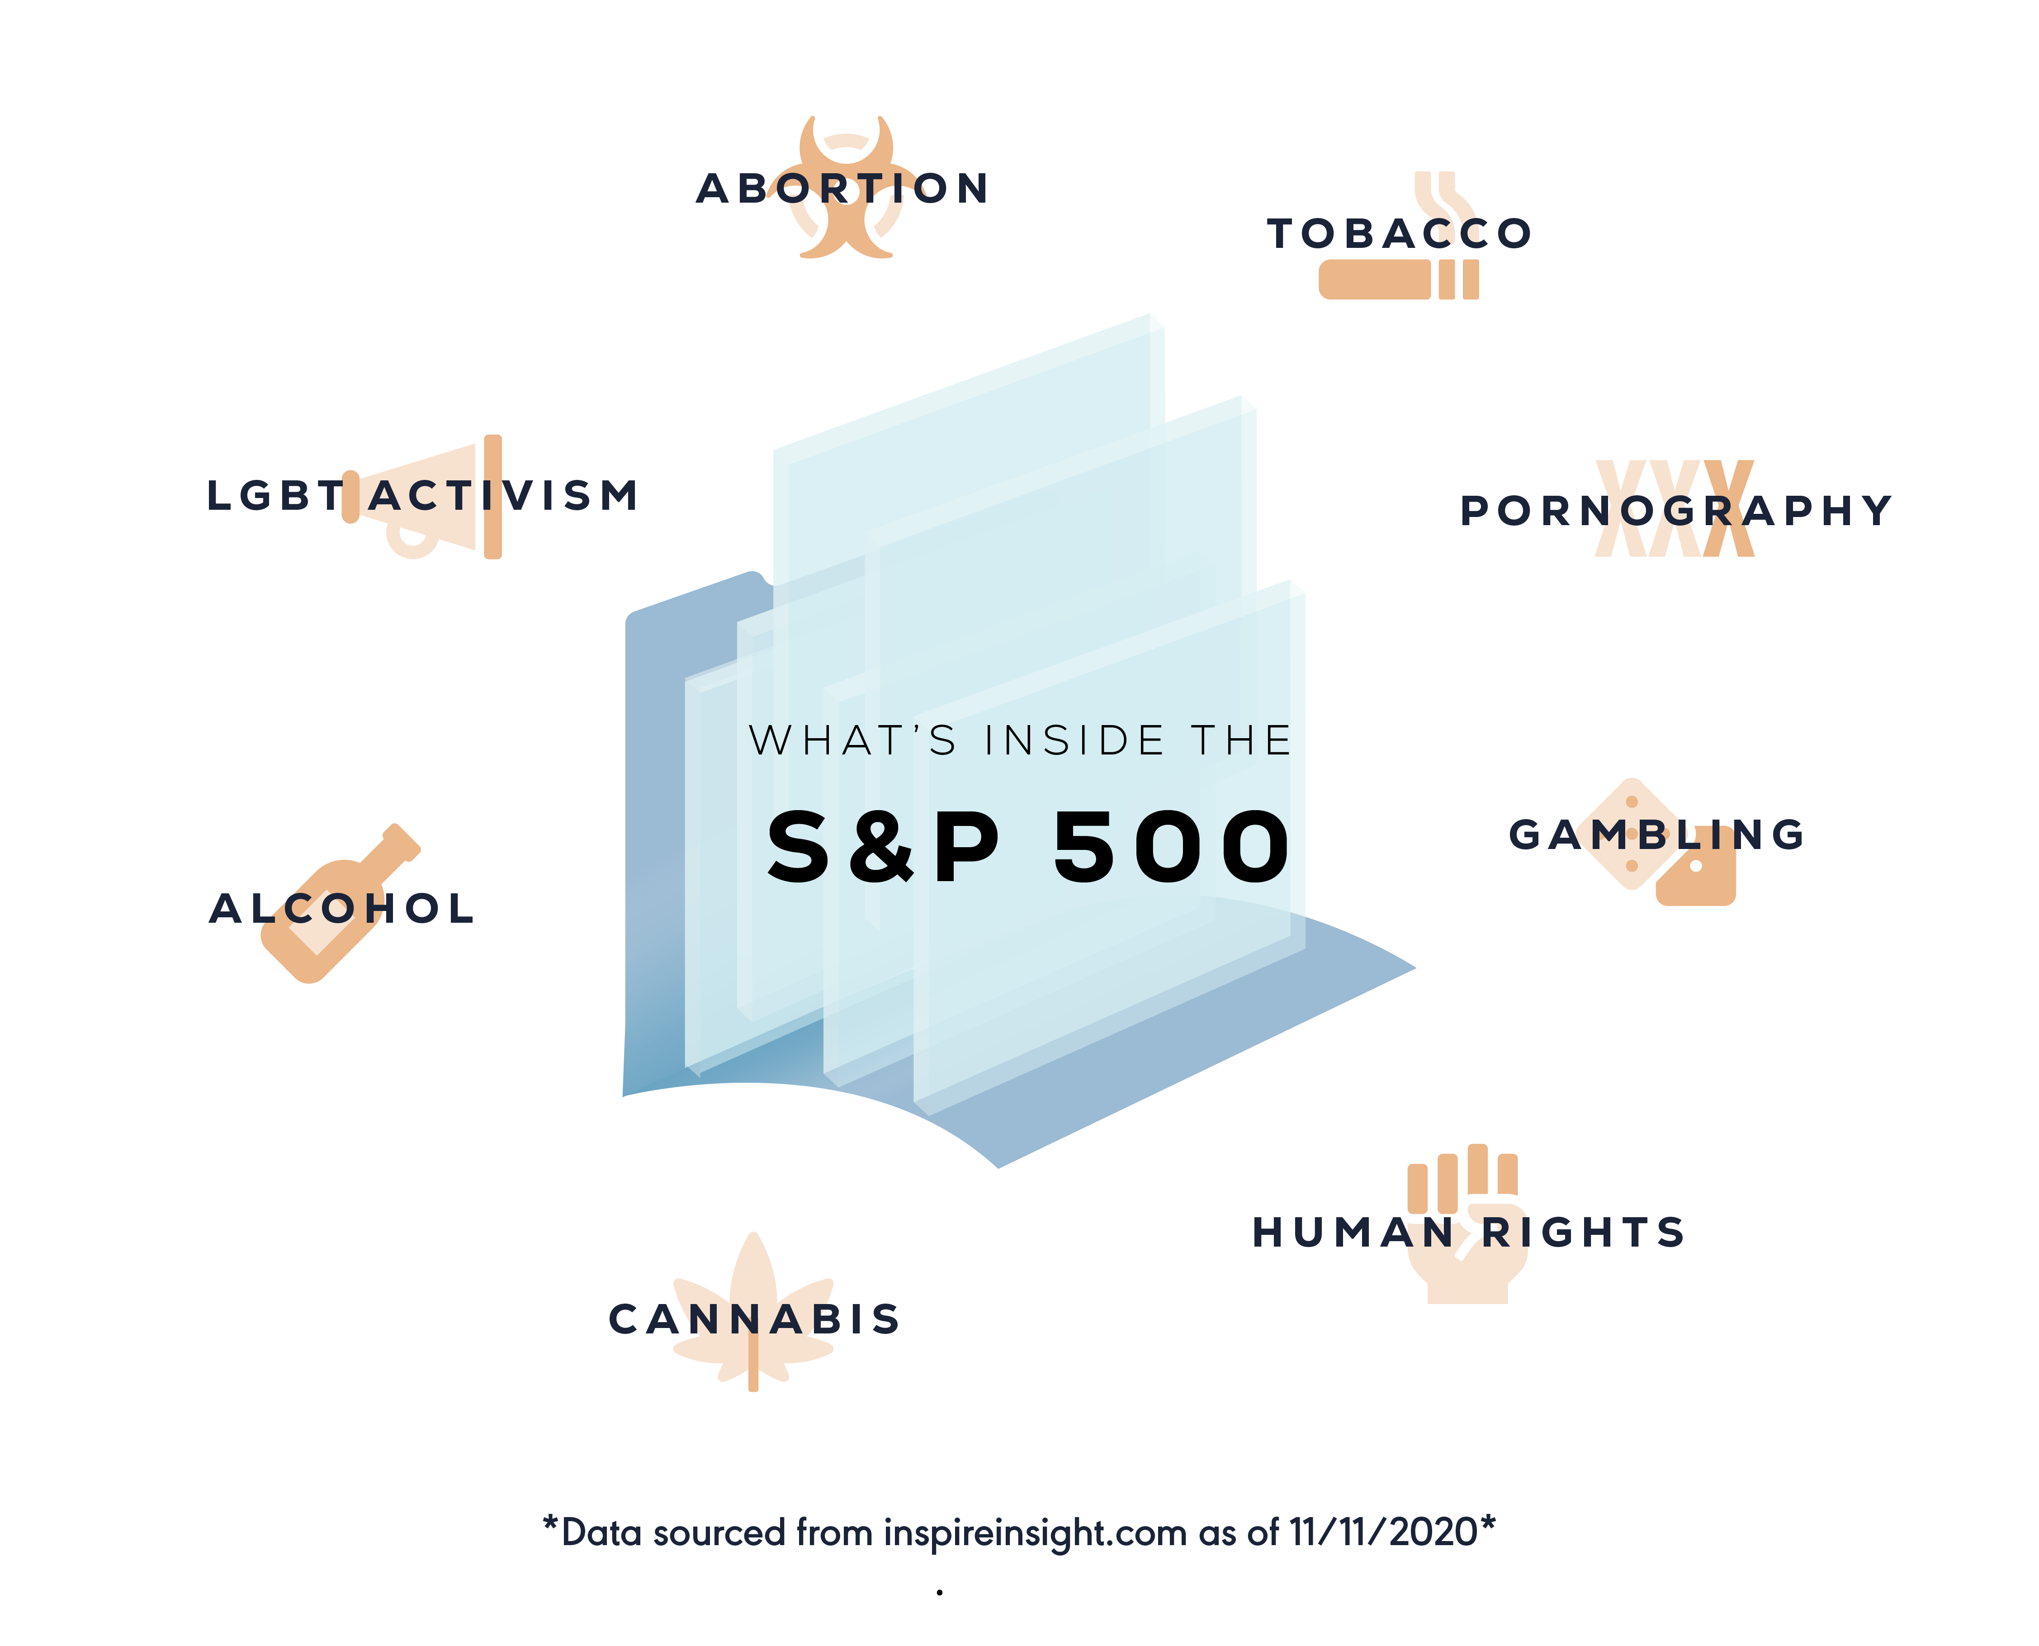
What are you really invested in?
Notes:
The problem is, most investors have no idea what they are really invested in from an ESG/values based perspective.

Slide 8

Biblical teaching on investing

Slide 9
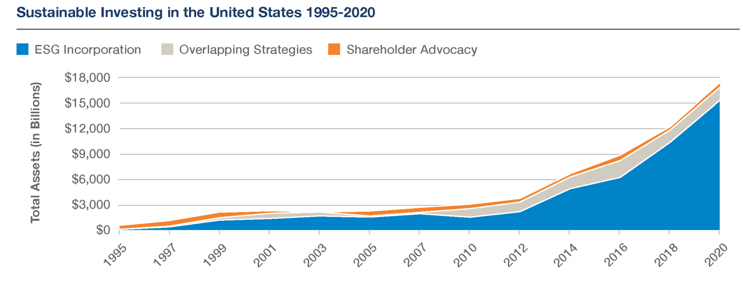
Rise of the Screened
Investments
Secular & Faith based market
$16.6
Trillion!
Source: U.S. SIF Foundation (2020)
(ESG) : Environment, Social, Governance.

Slide 10
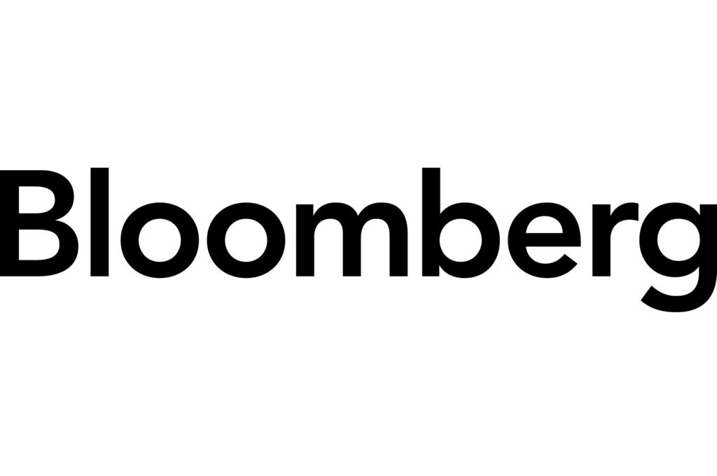

What the media says about BRI
“Perhaps it can even outperform the broader index or ESG [Environment, Social, Governance] portfolios. If so, it will attract lots of capital”
-Bloomberg.com
“As more clients care what companies are doing, investing based on Christian values gains traction.”
-The Wall Street Journal
“Biblically responsible investing (BRI) is a space with enormous potential.”
-The Wall Street Journal
“Christians control $6.7 trillion of assets in
the U.S., not counting their primary
residence, and they are increasingly looking
for an investment approach that supports
their point of view.”
-The Wall Street Journal
Source:
Bloomberg: Thou Shalt Not Buy Biblically Responsible ETFs (2017)
Wall Street Journal: Biblically Responsible Investing: A Lucrative Niche for Advisers (2017)

Slide 11
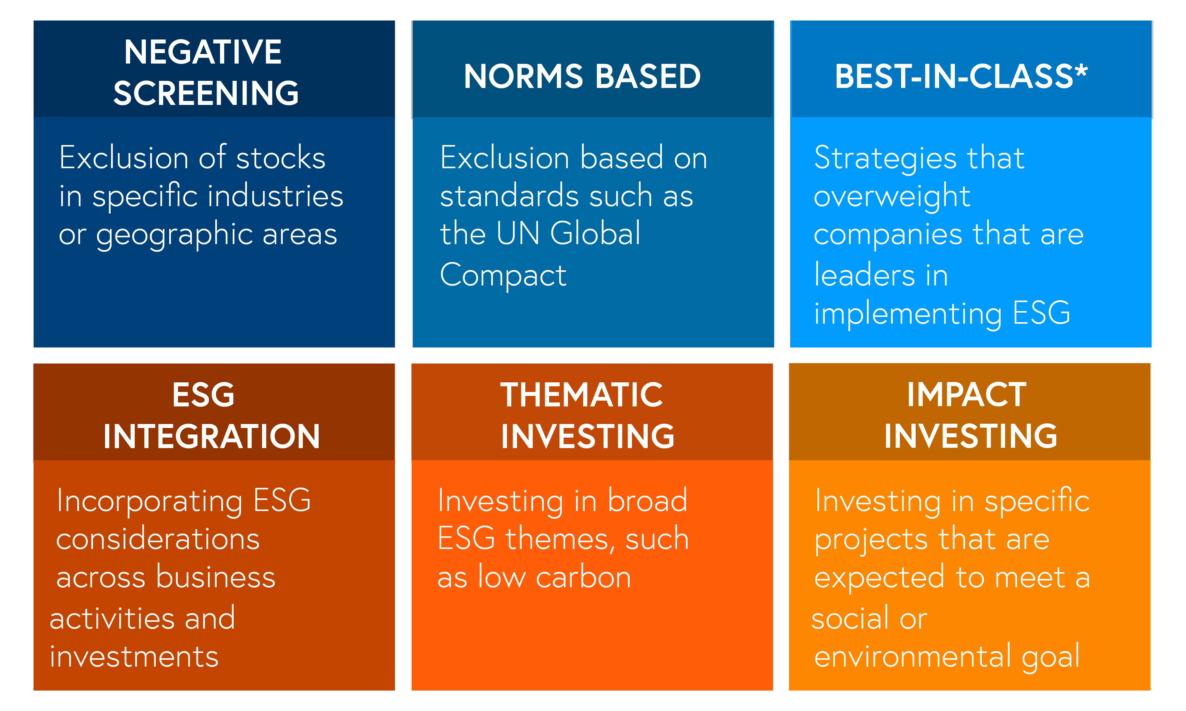
Different investment approaches
Source: Northern Trust: ESG Investing Why It’s Relevant and How to Implement (2017)
(ESG) : Environment, Social, Governance.
Notes:
No matter which approach you use, you can apply it through a biblical perspective.

Slide 12
Financial boycott
How
BRI started
Below average track record
No-index option
High Fees
“Not bad” doesn’t mean it’s “good”
Source: Northern Trust: ESG Investing Why It’s Relevant and How to Implement (2017)
(ESG) : Environment, Social, Governance.
Notes:
No matter which approach you use, you can apply it through a biblical perspective.

Slide 13

Where BRI is going
Source: Northern Trust: ESG Investing Why It’s Relevant and How to Implement (2017)
(ESG) : Environment, Social, Governance.
Notes:
No matter which approach you use, you can apply it through a biblical perspective.

Slide 14

Performance
&
Research

Slide 15
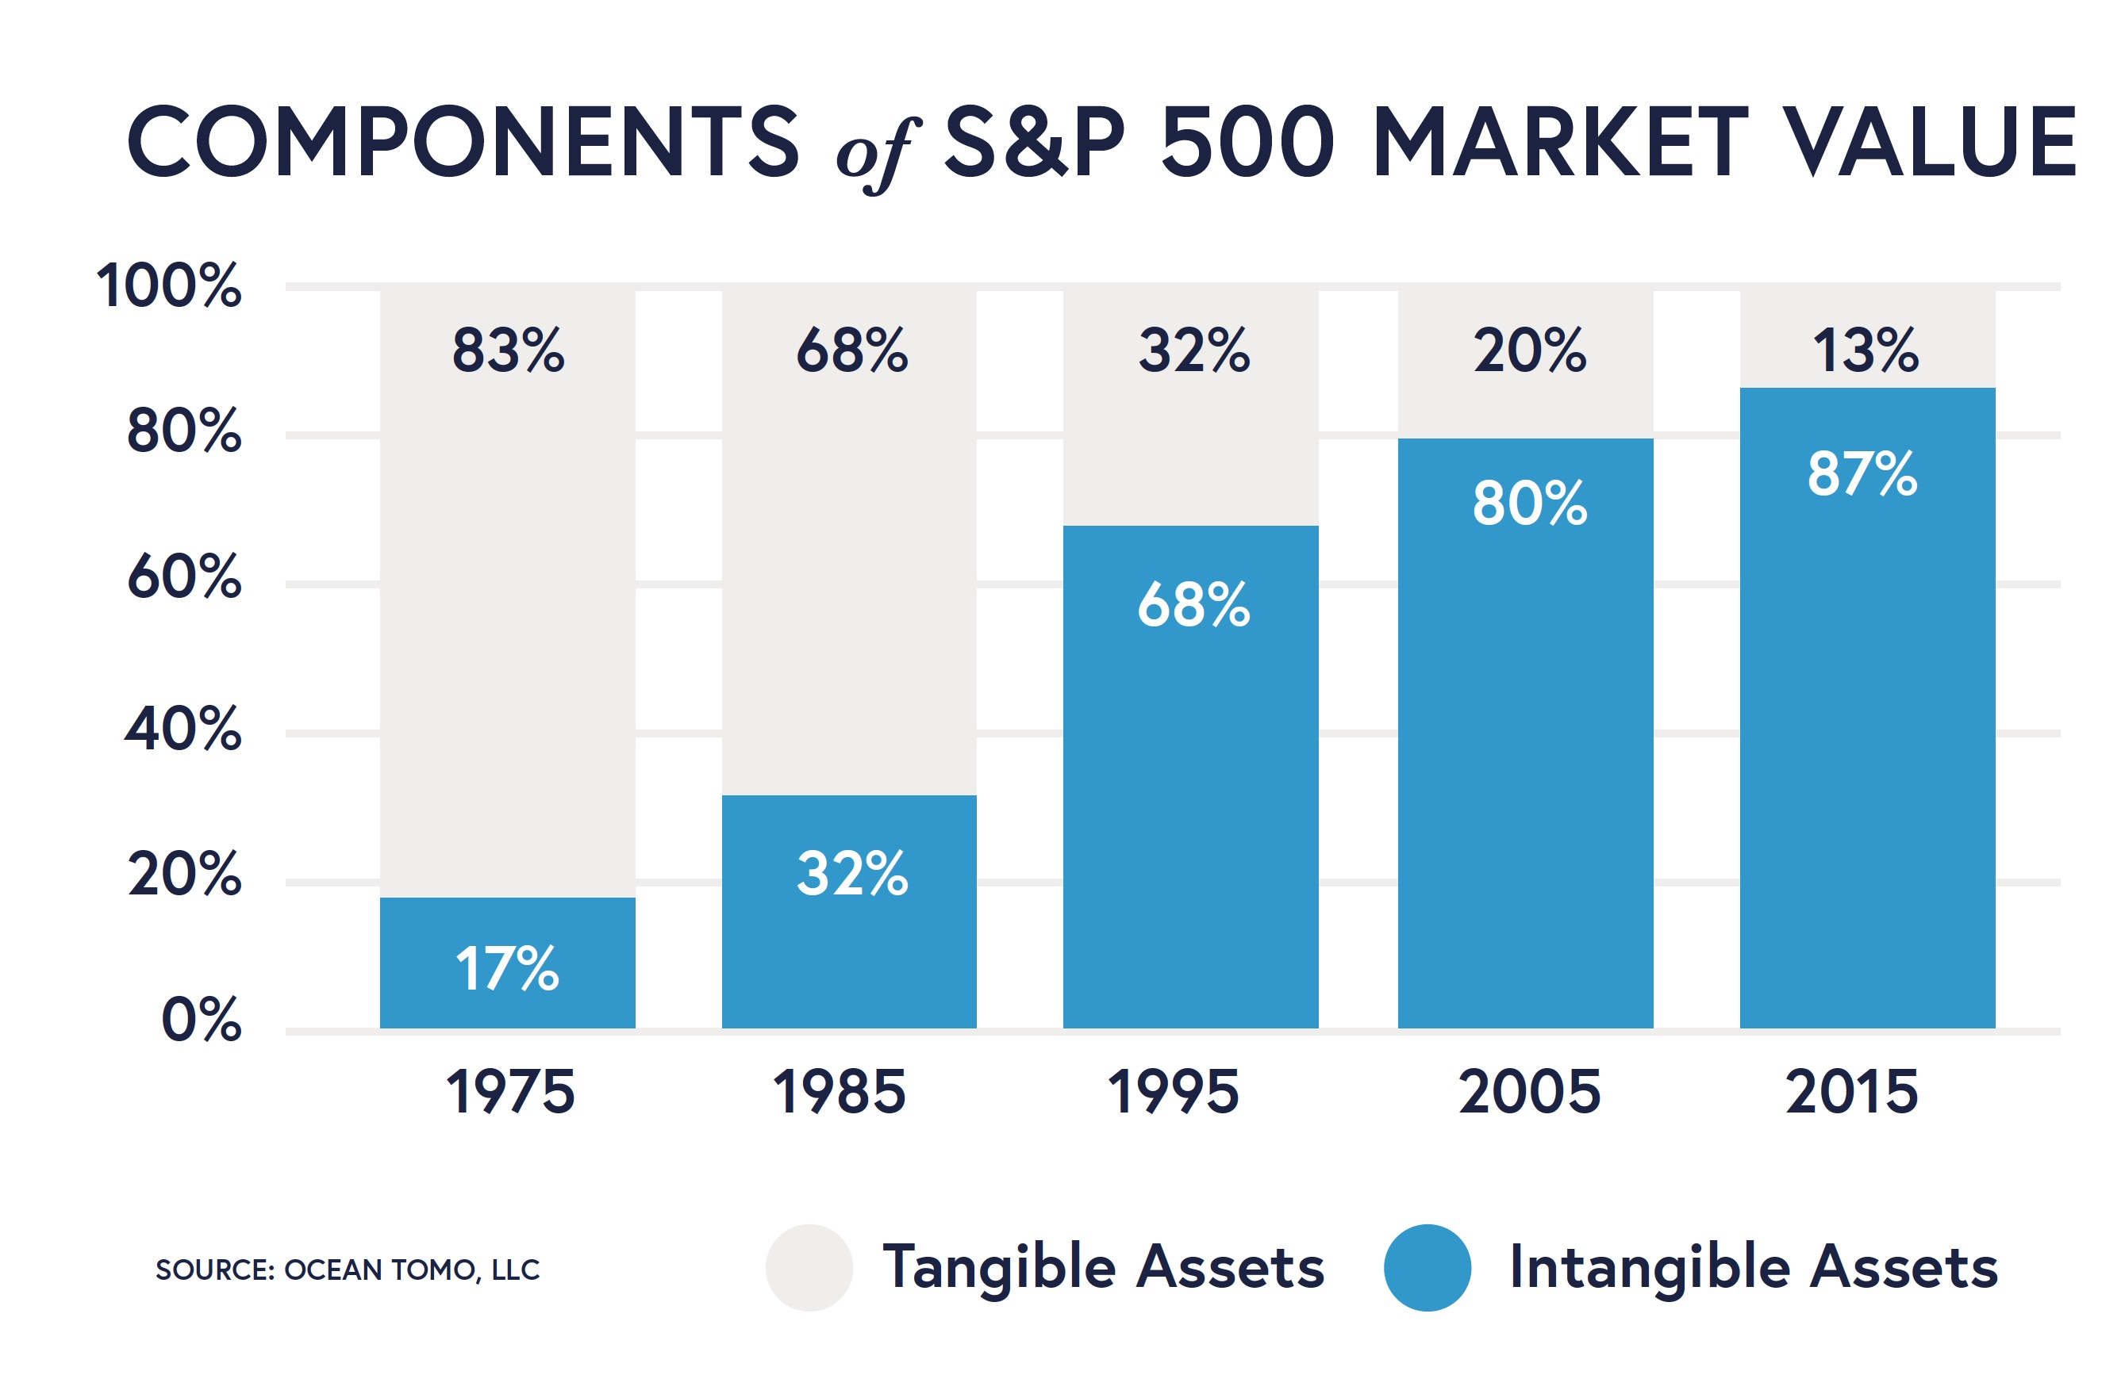
Intangible
Value

Slide 16



“The results of the study found that the [biblical investing] methodology of security selection resulted in an annualized outperformance compared to the non-screened benchmark.”
  -Biola University 2016
“88% of the studies show that solid ESG practices result in better operational performance.”
“80% of the studies show that stock price performance is positively influenced by good sustainability practices.
  -Oxford University 2014
Research
“Sustainable Investing Research Suggests No Performance Penalty”
  -Morningstar 2016
Sources:
1. http://corporate1.morningstar.com/ResearchLibrary/article/779995/sustainable-investing-research-suggests-no-performance-penalty/
2. https://sustaincase.com/oxford-university-corporate-sustainability-and-profitability-are-interrelated/
3. https://www.biola.edu/crowell/about/partnerships/biola-inspire-research-institute/white-papers#performance_attribution_sri

Slide 17
Recap
What is Biblically Responsible Investing
Current solutions
Performance & Research

Slide 18
1.
2.
3.
Next Step
DISCOVER
EXPLORE
IMPACT
Discover what you own
Explore what biblical investing would look like
Impact the world for God’s glory

Slide 19
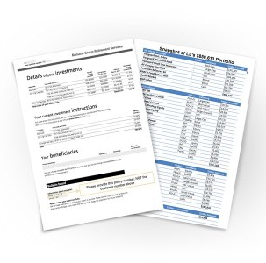
To do this analysis we need:
1.
2.
3.
Ticker Symbols
Dollar value (or) allocation percentage
Getting Started
DISCOVER
EXPLORE
IMPACT
Discover what you own
Explore what biblical investing would look like
Impact the world for God’s glory
Most recent investment account
statement makes it fast and easy
The Analysis is Completely Free!

Slide 20
ALIGN YOUR INVESTMENTS WITH YOUR VALUES
Insert advisors Contact info here:

