Slide 1


Biblically Responsible Investing
Quality Portfolios Built On Values
For professional use only. | Copyright © 2019

Slide 2
Disclosures
Insert advisors disclaimers here:
Investment advisory services offered through CWM Advisors, LLC dba Inspire, a registered investment advisor with the SEC.
All performance data presented herein is for illustrative purposes only and actual results may vary. Past performance is not a guarantee of future results.
National Admin Office: 650 San Benito St, Ste. 130 Hollister, CA 95023; Phone: (877)658-9473; Email: admin@inspireinvesting.com

Slide 3

Today’s
Speaker
Advisor Name
2-3 Sentence Bio

Slide 4


What is BRI?

Slide 5

Biblically Responsible Investing:
Building quality portfolios with some of the most inspiring,
biblically aligned companies in the world.
Notes:
The problem is, most investors have no idea what they are really invested in from an ESG/values based perspective.

Slide 6
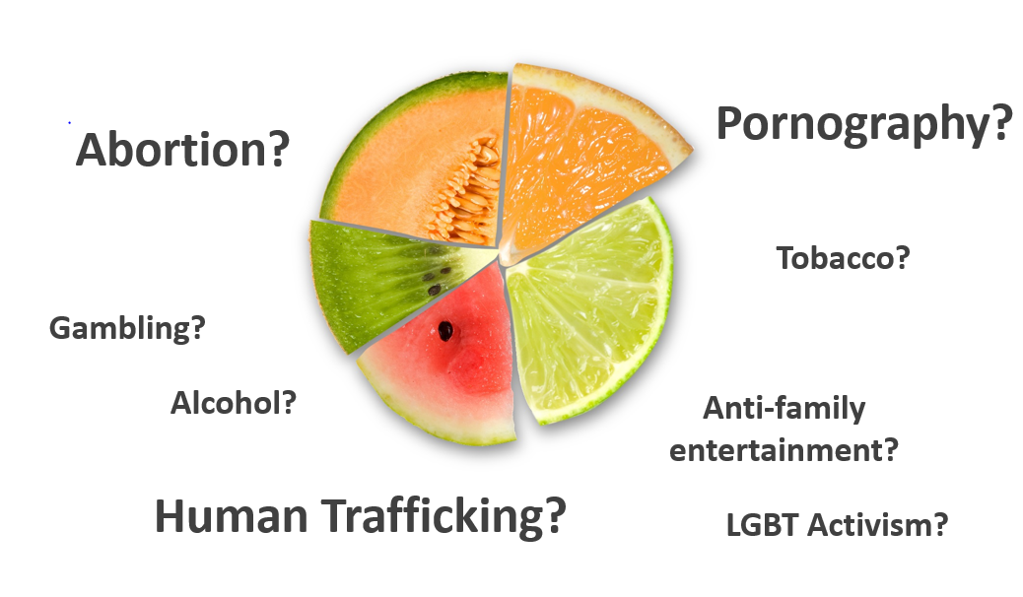
What are you really invested in?
Notes:
The problem is, most investors have no idea what they are really invested in from an ESG/values based perspective.

Slide 7
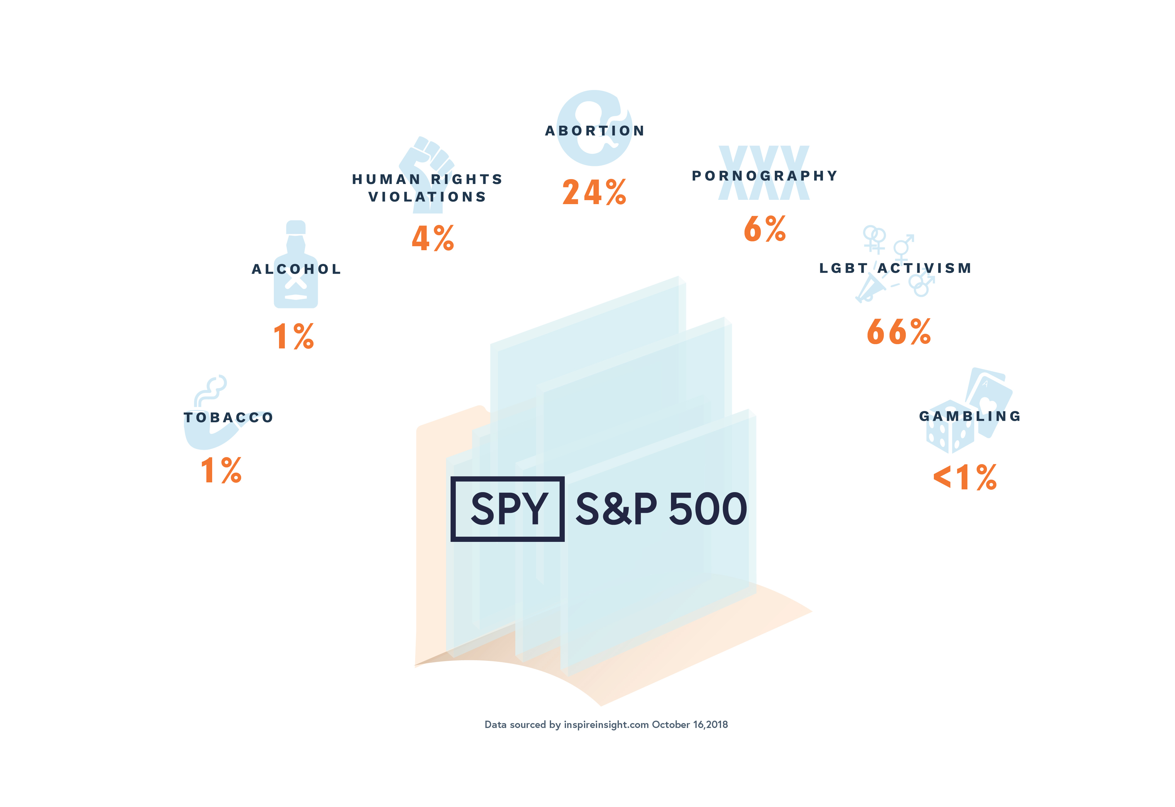
What are you really invested in?
Notes:
The problem is, most investors have no idea what they are really invested in from an ESG/values based perspective.

Slide 8

Biblical teaching on investing

Slide 9
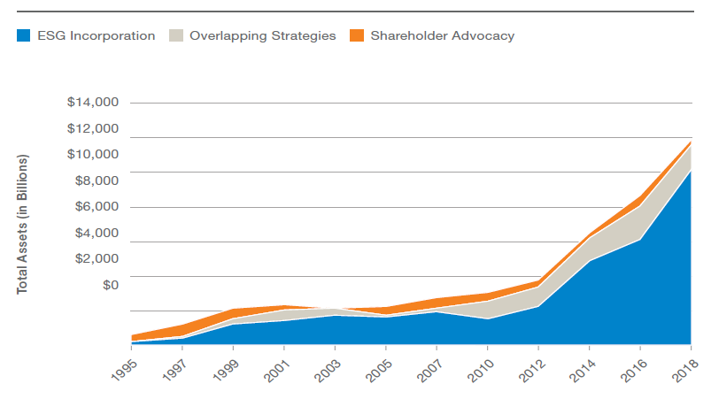
Rise of the Screened
Investments
Secular & Faith based market
$11.6 Trillion!
Source: U.S. SIF Foundation (2018)
(ESG) : Environment, Social, Governance.

Slide 10


What the media says about BRI
“Perhaps it can even outperform the broader index or ESG [Environment, Social, Governance] portfolios. If so, it will attract lots of capital”
-Bloomberg.com
“As more clients care what companies are doing, investing based on Christian values gains traction.”
-The Wall Street Journal
“Biblically responsible investing (BRI) is a space with enormous potential.”
-The Wall Street Journal
“Christians control $6.7 trillion of assets in
the U.S., not counting their primary
residence, and they are increasingly looking
for an investment approach that supports
their point of view.”
-The Wall Street Journal
Source:
Bloomberg: Thou Shalt Not Buy Biblically Responsible ETFs (2017)
Wall Street Journal: Biblically Responsible Investing: A Lucrative Niche for Advisers (2017)

Slide 11
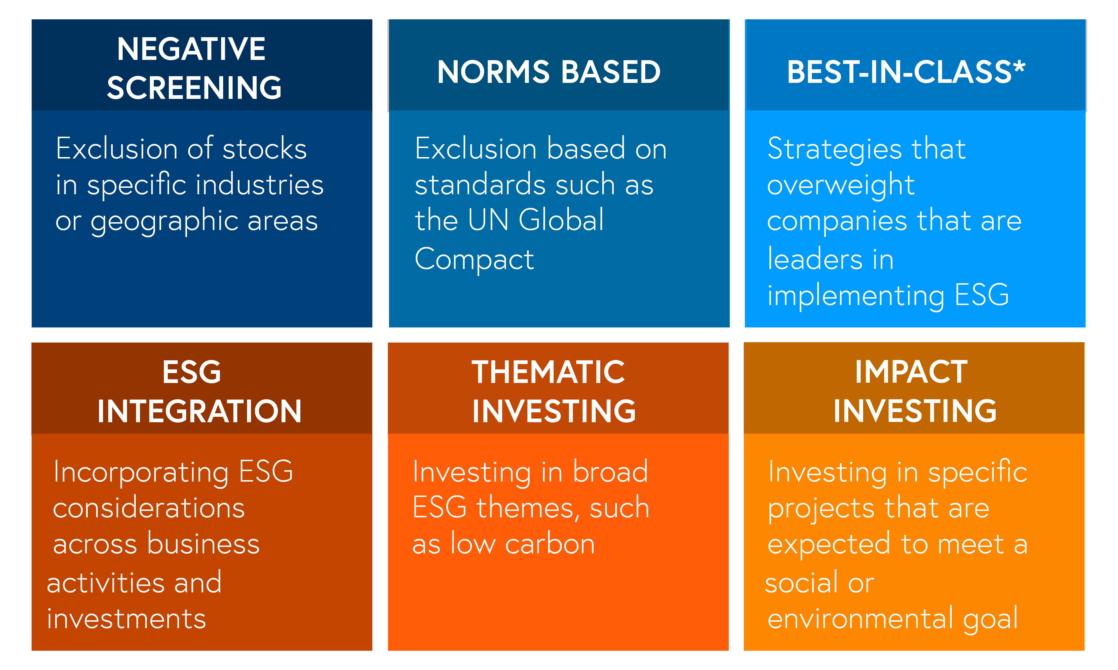
Different investment approaches
Source: Northern Trust: ESG Investing Why It’s Relevant and How to Implement (2017)
(ESG) : Environment, Social, Governance.
Notes:
No matter which approach you use, you can apply it through a biblical perspective.

Slide 12
Financial boycott
How
BRI started
Below average track record
No-index option
High Fees
“Not bad” doesn’t mean it’s “good”
Source: Northern Trust: ESG Investing Why It’s Relevant and How to Implement (2017)
(ESG) : Environment, Social, Governance.
Notes:
No matter which approach you use, you can apply it through a biblical perspective.

Slide 13


Inspire was born to fill the gap

Slide 14




The
Inspire Way
Positive
BRI
Identify the most inspiring companies
Range from -100 to +100
Invest in companies closest to +100
Proprietary database of thousands of company scores
The Inspire Impact Score®, is a proprietary selection methodology that is designed to assign a score to a particular security based on
the security’s alignment with biblical values and the positive impact that company has on the world through various environmental, social
and governance criterion. (BRI) Biblically Responsible Investing

Slide 15
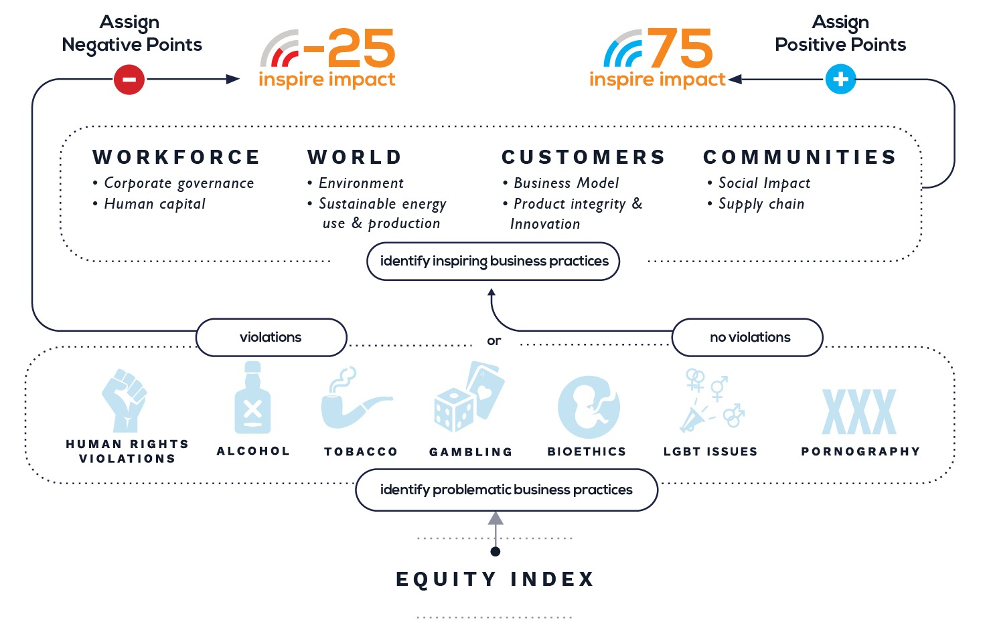
Screening
Flowchart

Slide 16

Inspire checks all the boxes
Source: Northern Trust: ESG Investing Why It’s Relevant and How to Implement (2017)
(ESG) : Environment, Social, Governance.
Notes:
No matter which approach you use, you can apply it through a biblical perspective.

Slide 17
Inspire Investing
INSPIRING TRANSFORMATION WITH FAITH-BASED ESG INDEX INVESTING
Founded: 2015
Headquarters: Silicon Valley, CA
Distinctives: Innovative, faith-based ESG index strategies combining competitive cost, factor investing and positive impact.
Accolades: Nominated finalist ETF.com Awards: “Best New ESG ETF – 2017”,“Best New ETF Issuer – 2017” and “Thematic ETF of the Year– 2018”
AUM: $555M discretionary assets under management (as of July 2019)
Thought Leadership: FOX Business, Wall Street Journal, Financial Times, New York Times, Bloomberg, Yahoo! Finance, Thomson Reuters, Huffington Post and other major media.
Clients: Global client footprint of institutions, foundations, family offices and individual investors
There is no guarantee that any investment will achieve its objectives, generate positive returns, or avoid losses. Past performance is no guarantee of future results.

Slide 18
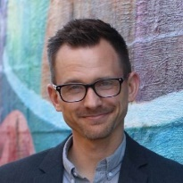
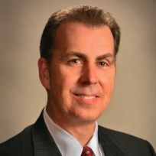
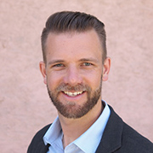
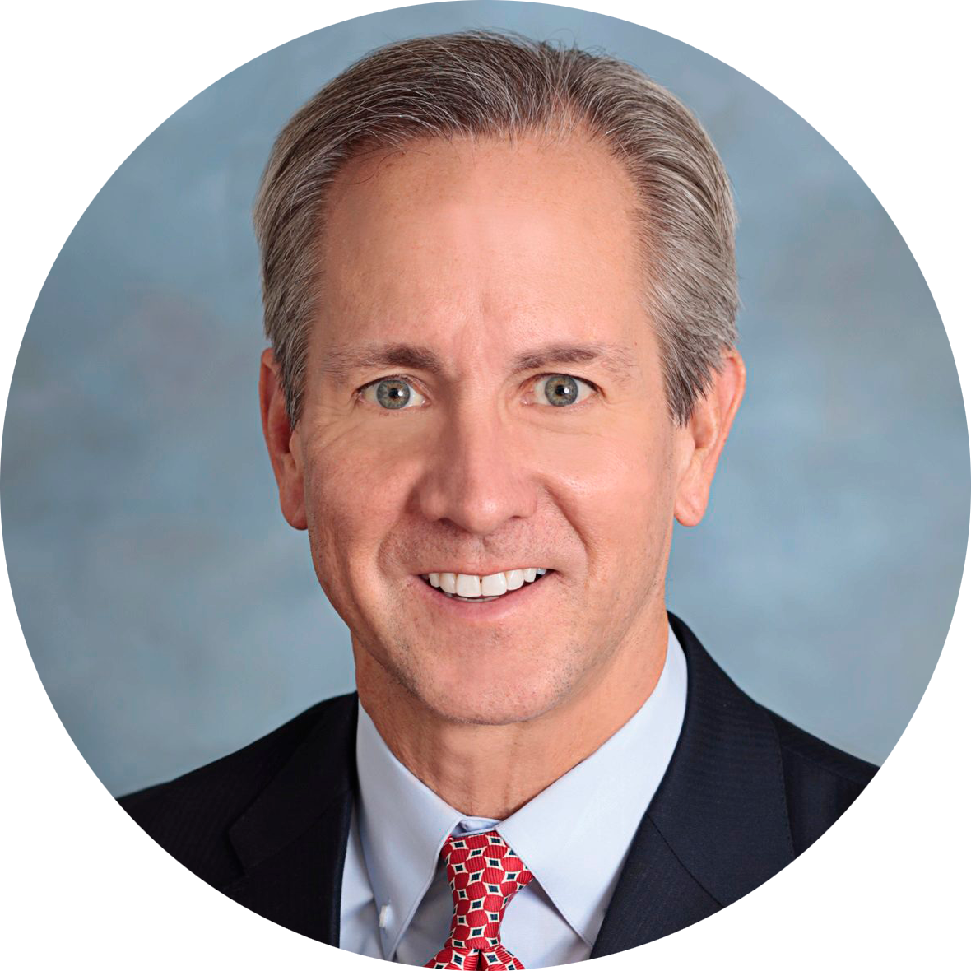
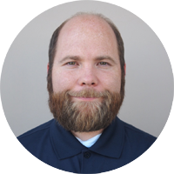
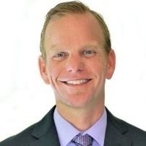
Leadership Team
Investment Team
Robert Netzly
CEO & President, Portfolio Manager
Founder, Inspire
#1 bestselling author of “Biblically Responsible Investing”
Previously at Wells Fargo Private Client Services.
Darrell Jayroe, CFA, CFP, CKA
CIO, Senior Portfolio Manager
23 years experience. Previously at Bank of Oklahoma, PaineWebber, Southwest Securities
Erik Davidson, DBA, CFA
Chief Economic Advisor
Former CIO for Wells Fargo Private Bank managing over $200B in assets.
Co-authored “Investing in Separate Accounts” and “The E-Finance Report” books
DBA in Behavioral Finance from the DePaul University Graduate School of Business.
Aaron Moon, MBA
COO/CCO
MBA from Biola University
Previously a financial advisor with Christian Wealth Management
Joseph Verissimo
VP Sales and Marketing
2012 FA MVP with Next Financial
Previously with Wells Fargo Advisors
Shane Enete, CFA
Investment Analyst
Chairman, Inspire Research Institute for BRI at Biola
Finance Professor, Biola University
Oversaw $200B assets at Meketa & Brandes

Slide 19



Inspire
Makes
Headlines
“This will be an interesting company to watch…”
–ETF Advisor Magazine
“The Chick-fil-A of investments.”
-Huffington Post
“the voice of Christian right investors.”
-Financial Times
Source:
ETF Advisor: Inspire ETFs Take Their Cue From The Bible (2017)
Huffington Post: Investment Company Creates Funds That Specifically Exclude LGBTQ-Friendly Stocks (2017)

Slide 20

Performance
&
Research

Slide 21
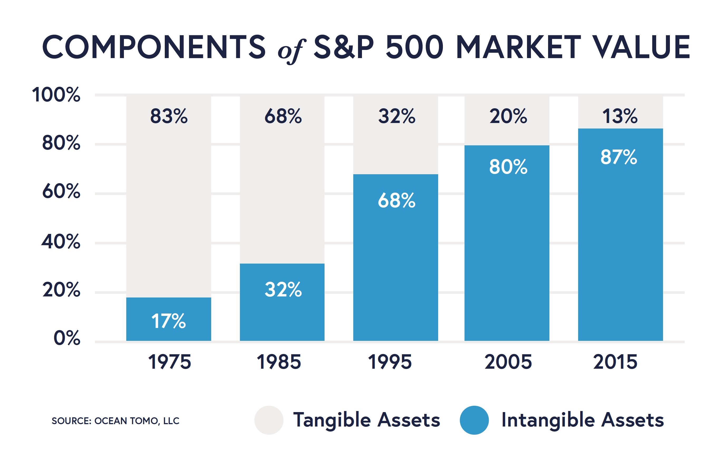
Intangible
Value

Slide 22
Good values and good returns are not mutually exclusive
Inspire Global Hope Index 6.91% | MSCI World EW Index 1.39% | Net positive +5.52%
Inspire 100 Index 12.82% | S&P 500 index 8.45% | Net positive +4.37%
Inspire Small Mid Cap Index 9.42% | S&P 400 Mid Cap index 6.40% | Net positive +3.02%
Inspire Corporate Bond Index 2.85% | Bloomberg Barclays US Agg Bond index 2.97% | Net negative -0.12%
1
2
Age-Old
Myth
Debunked
1
3
1
3
1
4
5 year annualized performance as of 6/30/2019
1: www.inspireinvesting.com (2019)
2: www.msci.com/world (2019).
3: www.us.spindices.com/ (2019)
4: www.ishares.com (2019)
The Inspire 100 Index is a US large-cap equally weighted index. The Inspire Global Hope Large Cap Equal Weight Index is a global index comprised of large cap companies with 50% US, 40% developed international and 10% emerging markets exposure. Inspire Small/Mid Cap Impact Equal Weight Index is a US index comprised of 50% mid cap and 50% small cap stocks. Inspire Corporate Bond Impact Equal Weight Index is comprised of 250 investment-grade, intermediate term corporate bonds in the US issued by large cap companies. The MSCI World Index is a broad global equity index that represents large and mid-cap equity performance across 23 developed markets countries. The S&P 500 Index is an American stock market index based on the market capitalizations of 500 large companies having common stock listed on the NYSE or NASDAQ. The S&P MidCap 400 Index is comprised of U.S. stocks in the middle capitalization range. The iShares Core U.S. Aggregate Bond Index is composed of the total U.S. investment-grade bond market.

Slide 23



“The results of the study found that the [biblical investing] methodology of security selection resulted in an annualized outperformance compared to the non-screened benchmark.”
  -Biola University 2016
“88% of the studies show that solid ESG practices result in better operational performance.”
“80% of the studies show that stock price performance is positively influenced by good sustainability practices.
  -Oxford University 2014
Research
“Sustainable Investing Research Suggests No Performance Penalty”
  -Morningstar 2016
Sources:
1. http://corporate1.morningstar.com/ResearchLibrary/article/779995/sustainable-investing-research-suggests-no-performance-penalty/
2. https://sustaincase.com/oxford-university-corporate-sustainability-and-profitability-are-interrelated/
3. https://www.biola.edu/crowell/about/partnerships/biola-inspire-research-institute/white-papers#performance_attribution_sri

Slide 24
Kingdom Impact

Slide 25
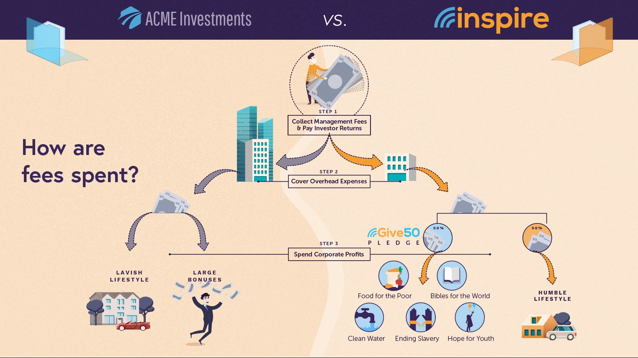

Slide 26


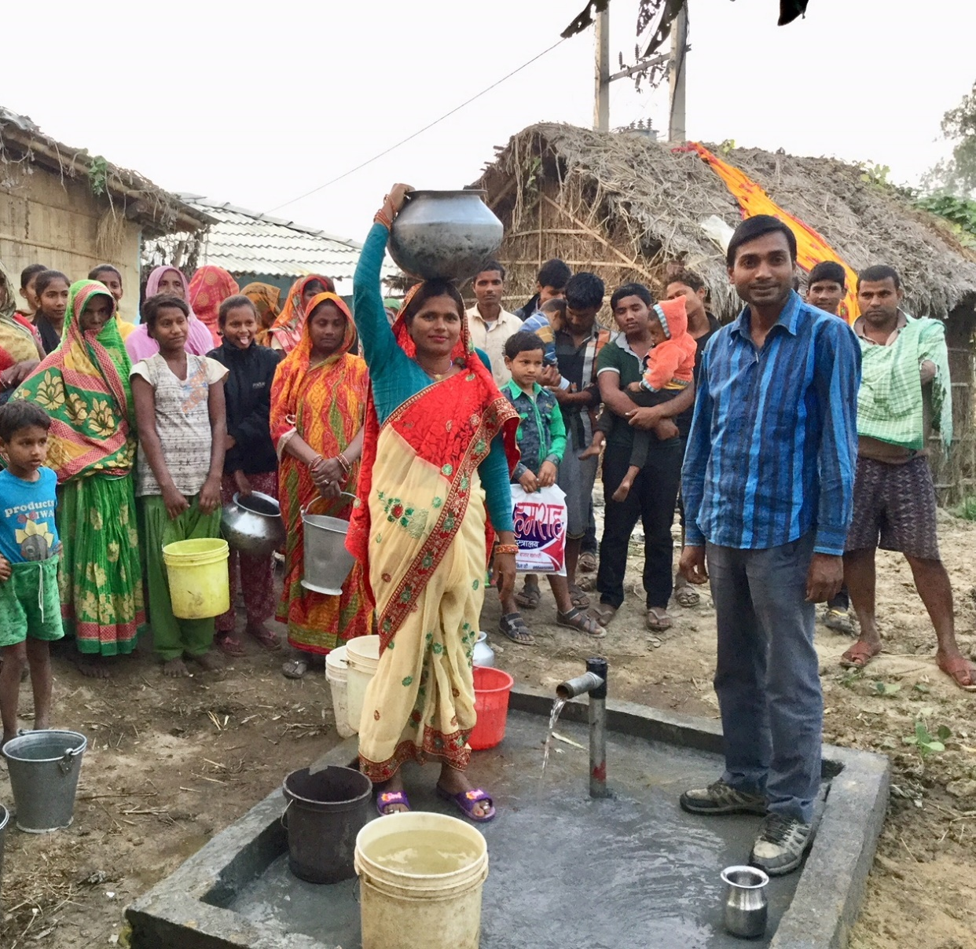



Inspire gives away 50% or more of the profits we earn from our management fees every year, donating them to Christian ministries to create meaningful change in the lives of people all around the world.
Inspire well in Birendranagar, Nepal.

Slide 27
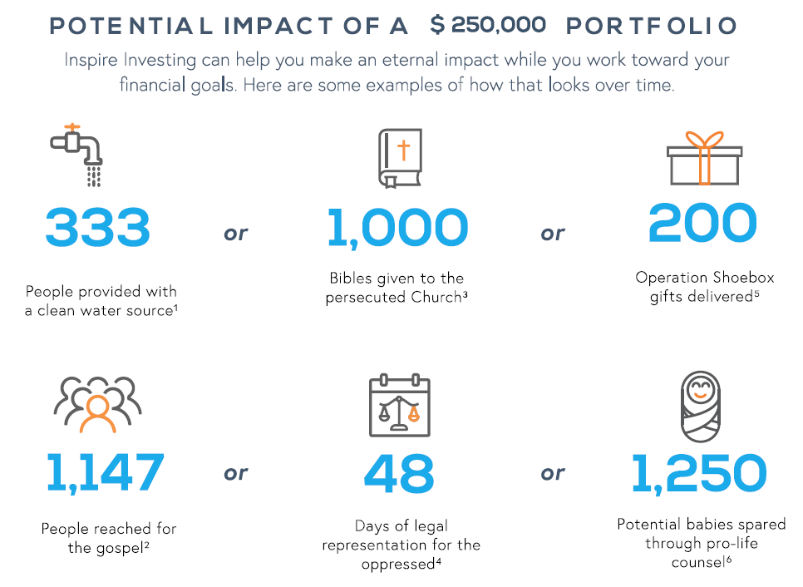
Potential
Impact
IMPACT DATA SOURCES:
1. WorldHelp.net: $15 provides clean water for 1 person.
2. JesusCares.com: Cost per visitor to JesusCares.com ($4.36 each)
3. WorldHelp.net: $5 provides one Bible to Christians in persecution
4. International Justice Mission (www.ijm.org): $105 to cover trial
fees for one case defending a victim of human trafficking.
5. Samaritanspurse.org: $25 provides a shoebox to one needy child.
6. Heartbeatinternational.org: $4 provides one consultant call to a
frightened pregnant woman
Impact estimates based on Inspire donating an average of 0.10% of initial investment for 20 years. Does not include calculation for potential growth rate of assets over time. Actual donations may be higher or lower depending on growth rate, length of time assets are he1d at Inspire, and other factors. Donation amounts, performance, profit and other factors are not guaranteed. Donations are paid by Inspire from the revenues generated by all of our products and services. Calculation of minimum annual donation amount is (Revenue Expenses}*50%.

Slide 28

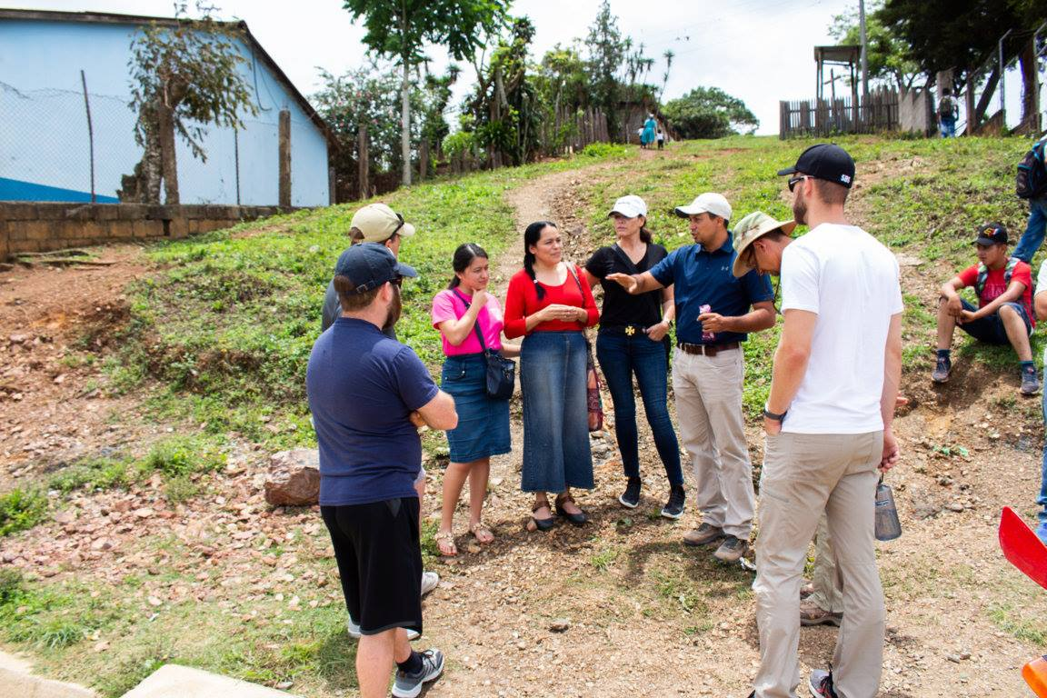
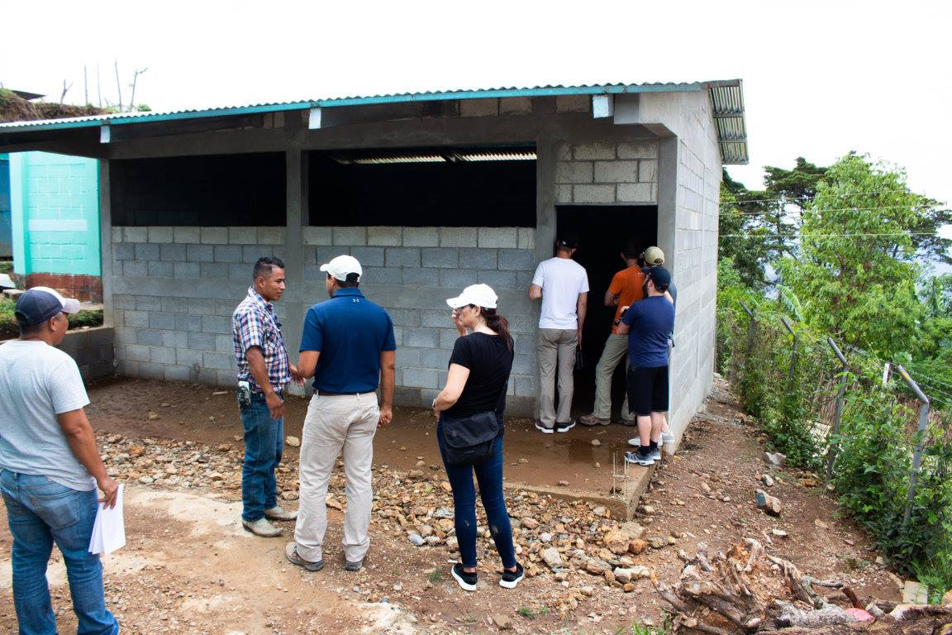
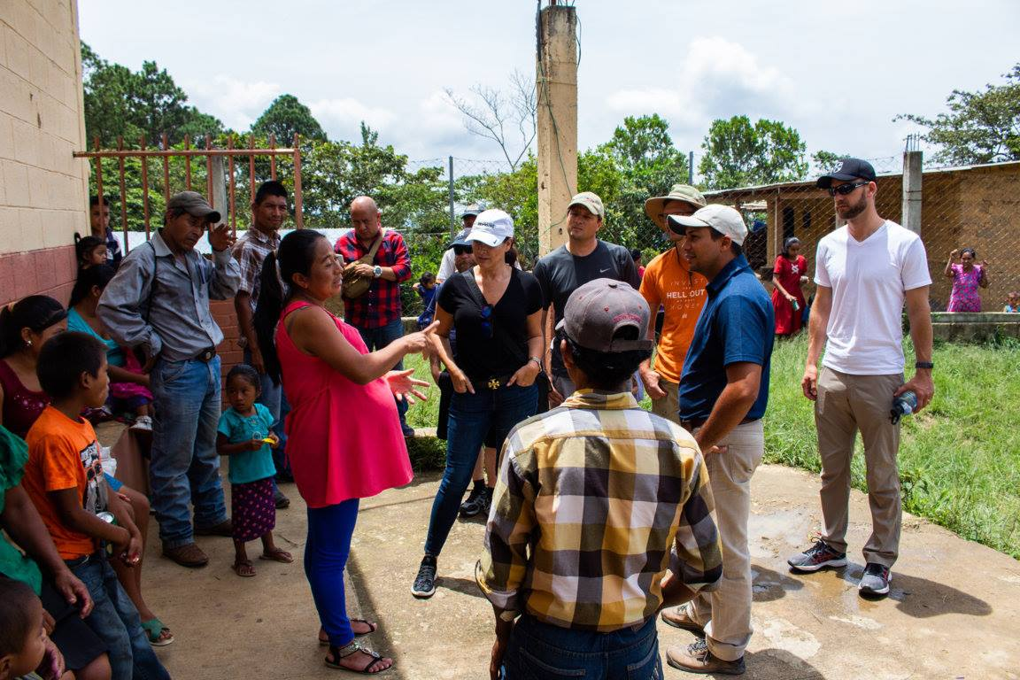


Guatemala Village Transformation Project
Emergency Fund
Pastor in the village of
Colonia Tawayni, La Union
Visit www.inspireinvesting.com/impact/village-transformation for more on this project

Slide 29
Recap
Biblically Responsible Investing
Inspire Impact Score
Performance & Research
Kingdom Impact

Slide 30
1.
2.
3.
Next Step
DISCOVER
EXPLORE
IMPACT
Discover what you own
Explore what biblical investing would look like
Impact the world for God’s glory

Slide 31
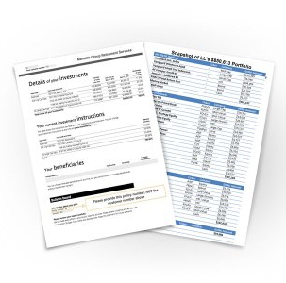
To do this analysis we need:
1.
2.
3.
Ticker Symbols
Dollar value (or) allocation percentage
Getting Started
DISCOVER
EXPLORE
IMPACT
Discover what you own
Explore what biblical investing would look like
Impact the world for God’s glory
Most recent investment account
statement makes it fast and easy
The Analysis is Completely Free!

Slide 32
Invest in something that matters.
JOIN THE MOVEMENT
Learn more @ inspireinvesting.com

